Slide 1
INPUT,OUTPUT AND STORAGE DEVICES

Slide 2
INPUT DEVICES
Input - Any data or instruction entered to computer
Input device helps to communicate with computer
Helps to enter information and issue commands
Examples:
Keyboard
Mouse
Scanner
Microphone
Joystick
Light Pen

Slide 3
KEYBOARD
Most common and widely used
Made up of buttons called “KEYS”
Keys are arranged to sections:
Alphabet keys
Function keys
Numeric keys
Arrow keys
Command keys

Slide 4
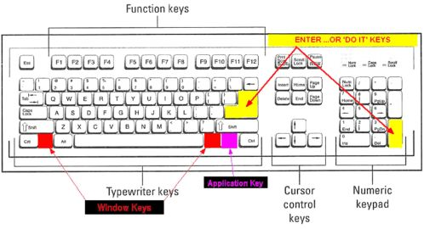

Slide 5
MOUSE
Pointing device
Used to control the movement of mouse pointer an to make selections
Types of mouse
Optical mouse – ball is replaced by optical system
Wheel mouse – contains scroll wheel
Cordless mouse – connected to computer using IF or radio signals

Slide 6
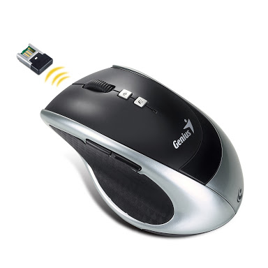
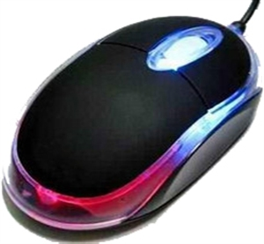
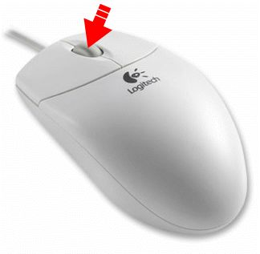
OPTICAL MOUSE WHEEL MOUSE CORDLESS MOUSE

Slide 7
SCANNER
Light sensing input device
Used to control the movement of mouse pointer an to make selections
Types of scanner:
Bar code reader– decodes information contained in bar codes
Optical Scanner– converts a documents text or graphics to digital data

Slide 8
MICROPHONE
Used to input sound that is stored in digital form
Also called as mic
Also lets you to others to communicate with others

Slide 9
JOYSTICK
Pointing device that works on principle of trackball
Function is same as mouse
It is a stick having spherical balls at both upper and lower ends
Can be moved in four directions

Slide 10
LIGHT PEN
Used to select a displayed menu item
Draw pictures on screen
Contains a photocell and an optical system
Detects screen location and sends corresponding signal to CPU

Slide 11
OUTPUT DEVICES
Input - Any piece of computer hardware equipment used to communicate the results of data processing
Converts the electronically generated information into human-readable form
Some types of output are text, graphics, tactile, audio and video
Text consists of characters
Graphics are digital representations of nontext information such as drawings, charts, photographs, and animation
Tactile output such as raised line drawings
Audio is music, speech, or any other sound.
Video consists of images played back at speeds to provide the appearance of full motion.

Slide 12
Examples:
Monitor
Printer
Plotter
Soundcard and Speaker

Slide 13
MONITOR
Commonly called as VDU(Visual Display Unit)
Main output device
Can display text as well as graphic images
Types of monitor
Cathode Ray Tube(CRT)-
Flat Panel Display

Slide 14
PRINTER
Used to print text or illustrations
Made up of buttons called “KEYS”
There are many types of printers:
Daisy-wheel
Dot-matrix
Ink-jet
Laser
LED

Slide 15
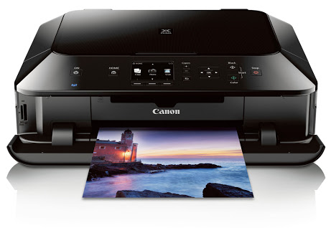

Slide 16
PLOTTER
Used to draw pictures on paper
Draw lines using a pen
Used in engineering applications
More expensive

Slide 17
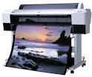

Slide 18
SOUNDCARD & SPEAKERS
Enable the computer to output sound
Allows users to listen to computer generated sound
Speakers are required to listen to music or video CD/DVD sound

Slide 19
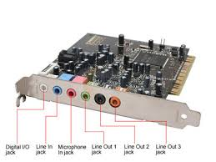
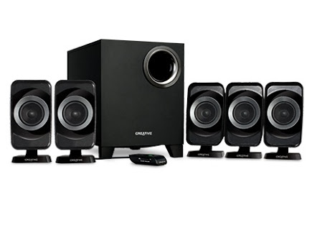

Slide 20
STORAGE DEVICES
Used to store data
Two types of Storage devices:
Primary-RAM,ROM
Secondary-HARD DISK,FLOPPY etc

Slide 21
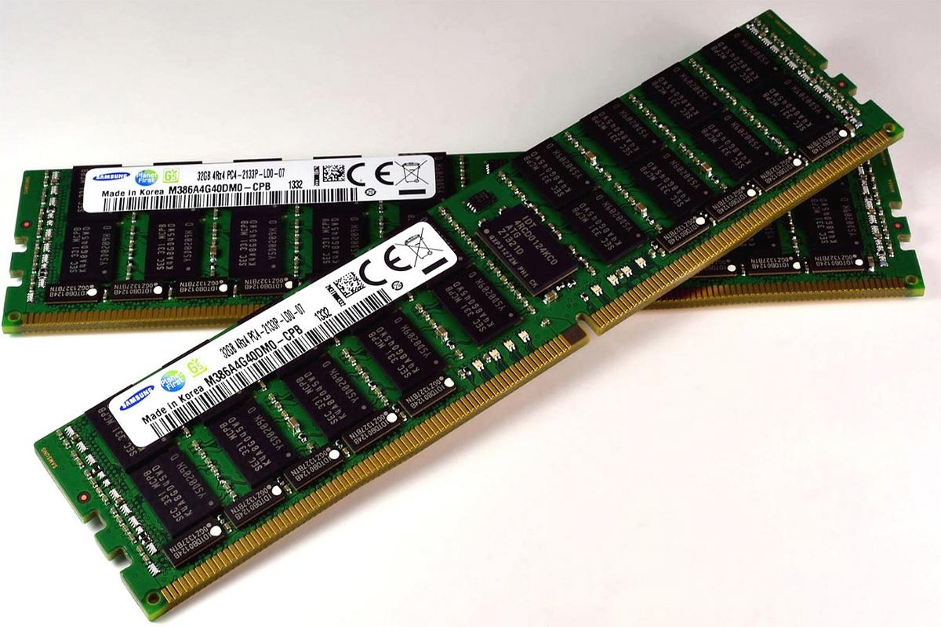
PRIMARY STORAGE DEVICES
RAM
RANDOM ACCESS MEMORY
Can read and write
Volatile
Two types
DRAM (Dynamic)
SRAM (Static)

Slide 22
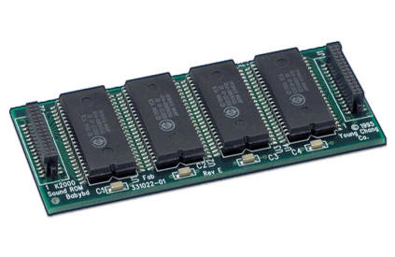
ROM
READ ONLY MEMORY
Information stored permanently
Access time is fast
Four types
PROM
EPROM
EEPROM
EAROM

Slide 23
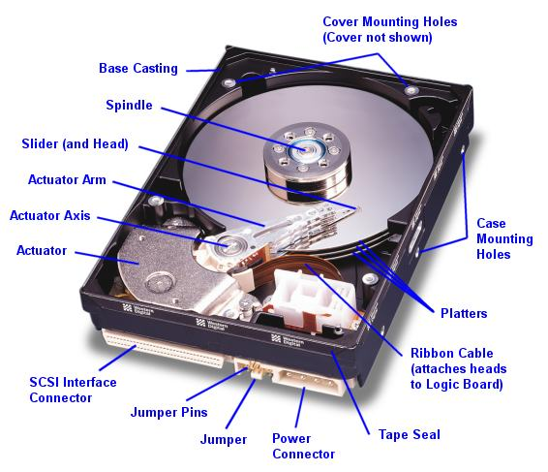
SECONDARY STORAGE DEVICES
HARD DISK
Made of aluminium or other metal alloys
Not removable
Several disks are packed together and mounted on a common drive

Slide 24
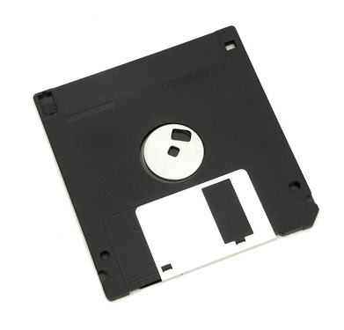
FLOPPY DISK
Circular disk coated with magnetic oxide enclosed within plastic cover
Available in different sizes
Data up to 1.4 MB can be stored
Data written as tiny magnetic spots

Slide 25
OPTICAL MEDIA
Works by creating a disc with pitted metallic surface
Available in different types ranges from 650 MB to 128 GB
CD-ROM - 650
CD-R -900
CD-RW -900
DVD
BLUE RAY

Slide 26
FLASH DRIVE
Solid state
Plug & play
Portable
More data storage

Slide 27
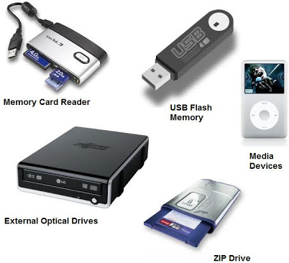

Slide 28
QUESTIONS……?????

Slide 29
THANKS….

